Slide 1




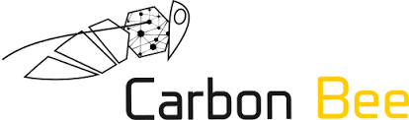

Machine learning
Cours 6 : Support Vector Machine
David Rousseau

Slide 2
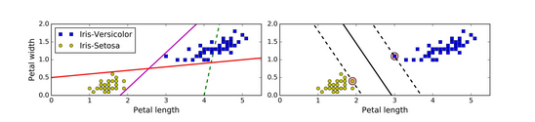
Support Vector Machine
A support vector machine is a very powerful and versatil Machine Learning model capable of performing linear or non linear classification regression and even outlier detection
It is one of the most popular models in Machine Learning
SVM is particularly well suited for classification of complex but small or medium sized datasets
To illustrate the principle we work on the Iris data base

Slide 3
Linear SVM classification
The two classes can clearly be separated easily with a straight line
The left plot shows decision boudaries of three possible linear classifiers
On the right the linear classifier not only separates the two classes but also stays as far away from the closest training instances as possible.
The classifier on the right fit the widest possible margin

Slide 4
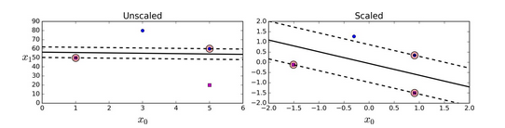
Importance of scaling
Warning SVM are sensitive to the feature scales

Slide 5
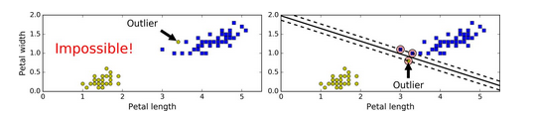
Soft margin
Two main issues with hard margin classification
It only works if the data are linearly separable
Sensitive to outliers

Slide 6
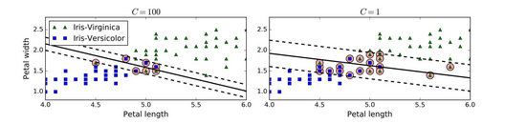
Influence of margin
To avoid this issues it is preferable to used a more flexible model
This flexibility of the margin is controlled using an hyperparameter C
The smaller C leads to more margin violotions
On the right using a low C value the margin is much larger but many instances end up in the margin. But this classifier will generalize better
If your SVM model overfits you can try regularizing it by reducing C

Slide 7
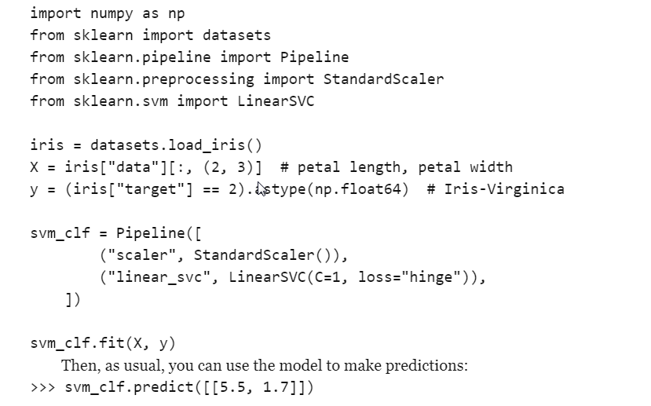
SVM with Scikit learn

Slide 8
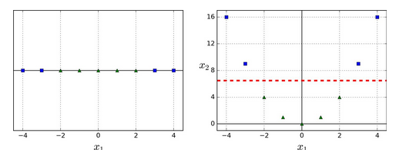
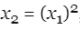
Non linear SVM classification
Many datasets are not linearly separable
One approach is to add more features (polynomial features)

Slide 9
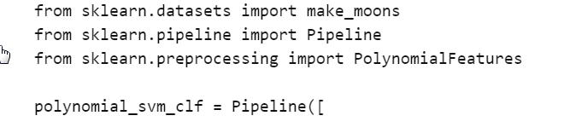
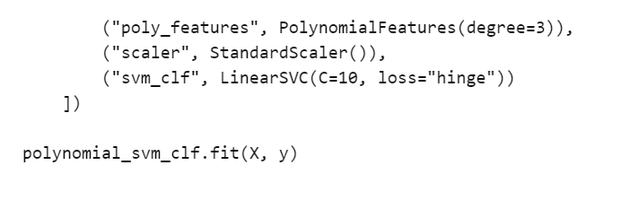
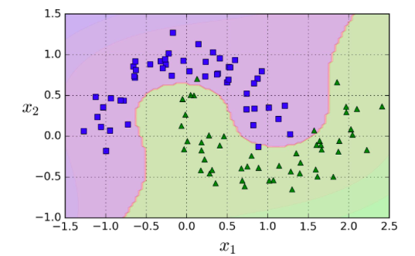
Nonlinear classification with Scikit learn

Slide 10
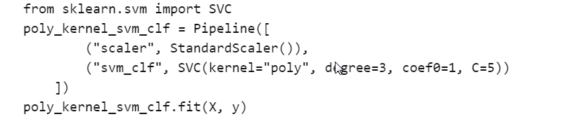
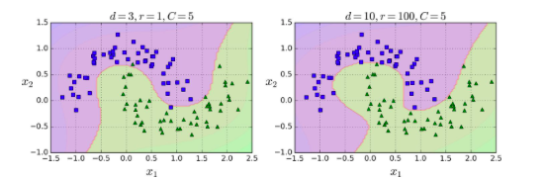
Polynomial kernel
Adding polynomial feature is simple and can work great with all sorts of Machine Learning algorithms
At low polynomial degree it cannot deal with very complex datasets and with a high polymial degree it creates a huge number of features making the model too slow
With SVM a trick called Kernel Trick

Slide 11
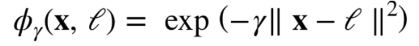
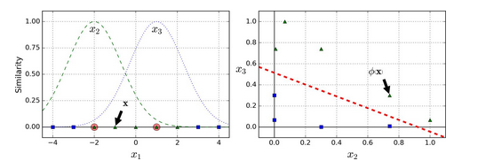
Similarity variables
Another technique to tackle nonlinear problems is to add features computed using similarity function that measures how much each instance resembles a particular landmarks
For example let’s take a 1 dimensional dataset and two landmarks.
We define the similarity function
How to choose landmarks ?
1 landmark per instance
Not adapted for large datasets

Slide 12
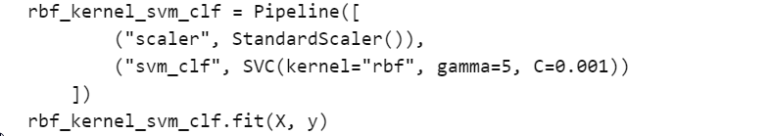
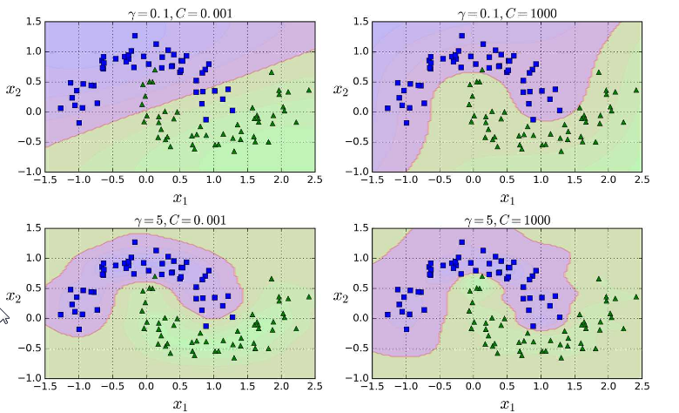
Gaussian RBF with Sci-kit learn

Slide 13
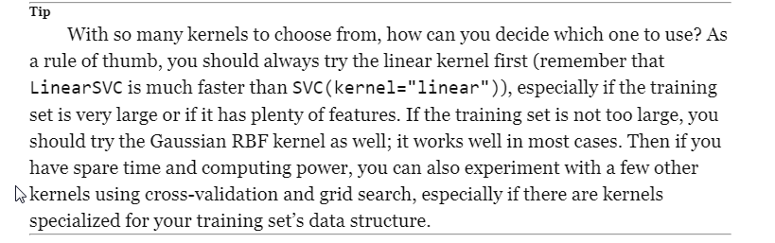
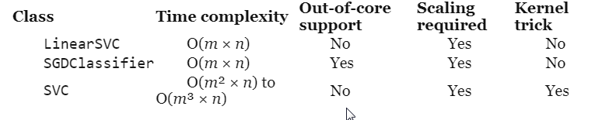
How to choose the kernel

Slide 14
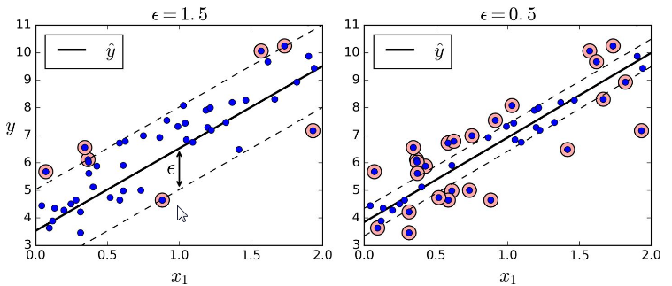
SVM linear Regression
To realize regression, we reverse the objective
Instead of trying to fit the largest possible margin
Fit as many instances as possible in the margin while limiting marging violations

Slide 15
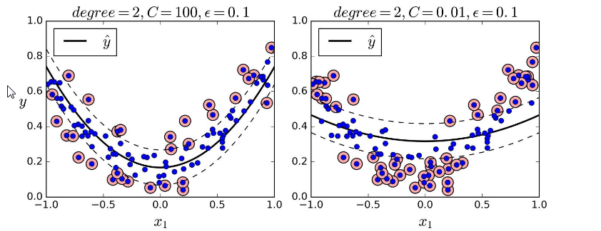
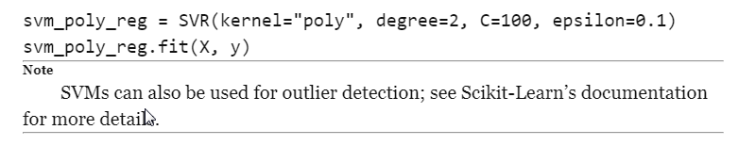
SVM nonlinear regression
Kernelized SVM model

Slide 16
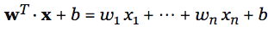
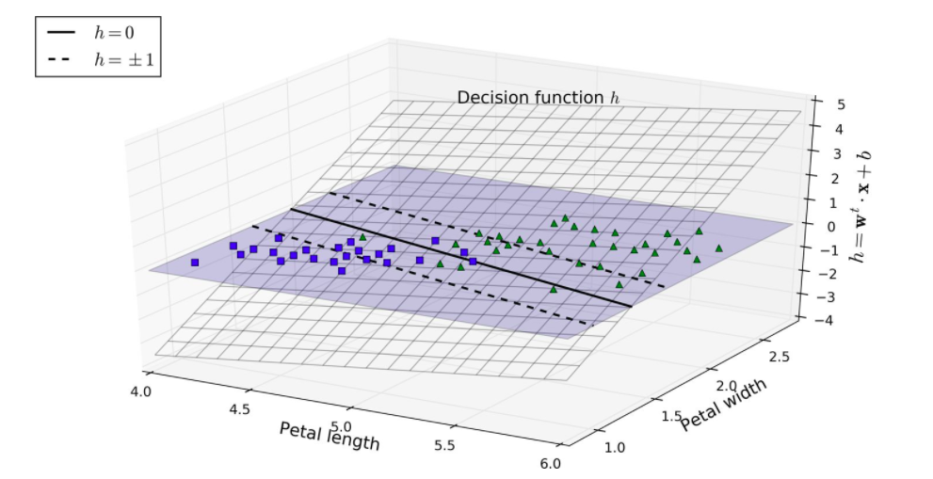
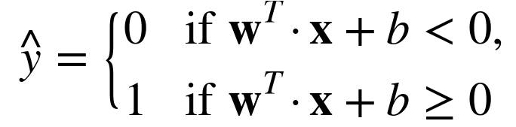
Inside the SVM blackbox
The linear SVM classifier predict the class of a new instance x by simply computing the decision function
If the result is positive, the predicted class y hat is possitive class (1) or else it is negative class (0)
Training a SVM classifier means finding the value of w and b that make this margin as wide as possible while avoiding margin violation

Slide 17
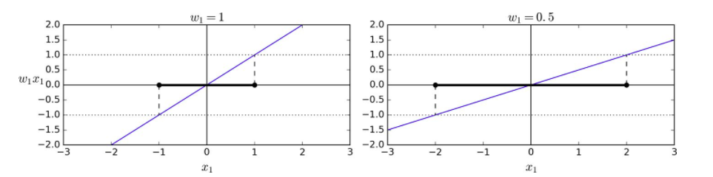
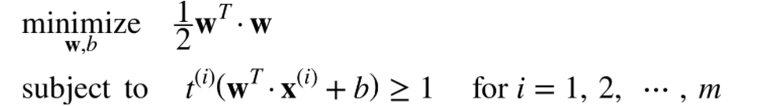
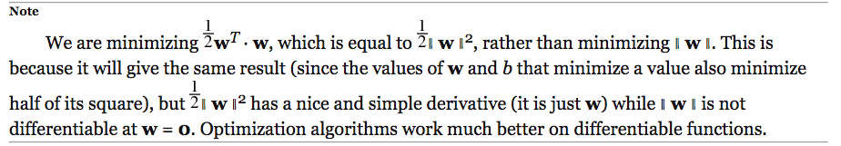
Training SVM
The slope of the decision function: it is equal to the norm of the weight vector w
The smaller the weight vector the larger the margin
We define t(i)=-1 for negative instances (if y(i)=0) and t(i)=1 for positives instances

Slide 18
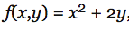
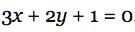
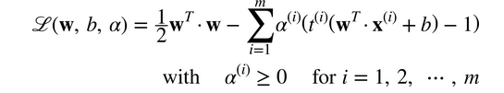
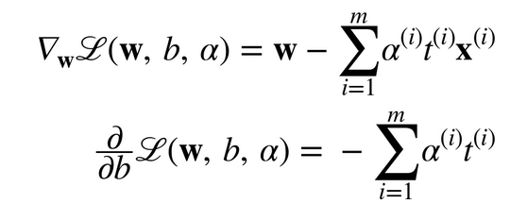
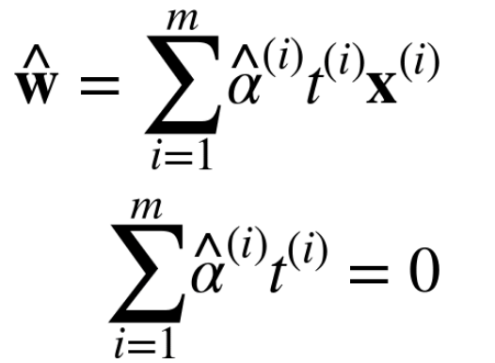
Introduction of the dual problem

Slide 19
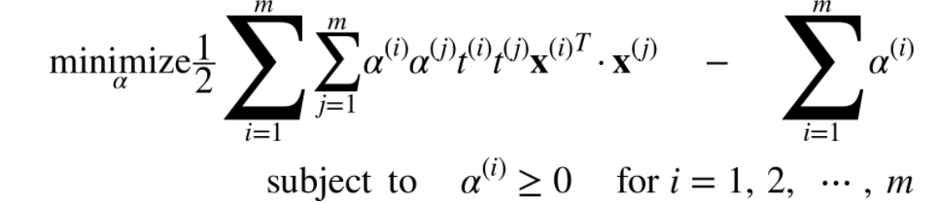
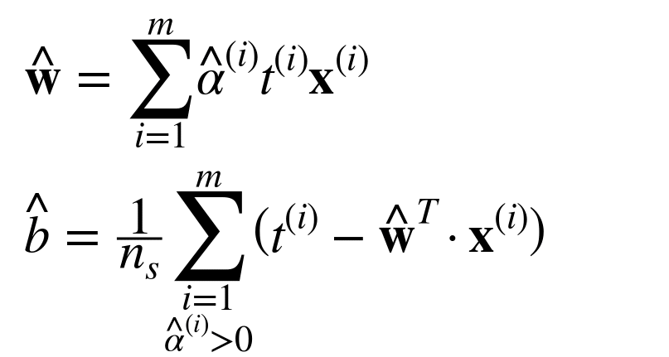
Dual problem
The dual problem is faster to solve than the primal when the number of training instances is smaller than the number of features

Slide 20
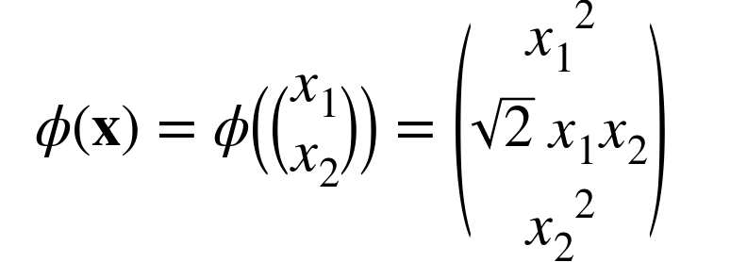
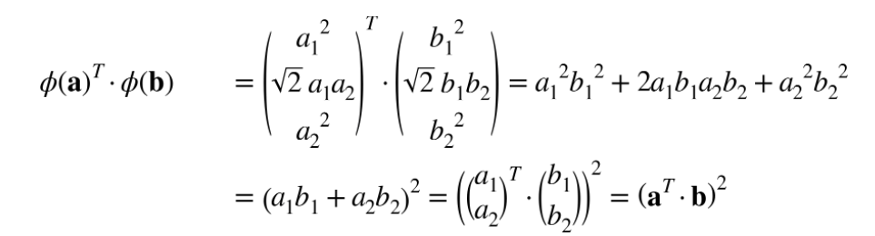
Kernelized SVM
Suppose you apply a second degree polynomial to a two dimensional problem
Now let’s apply this to two vector a and b
So you don’t actually need to transform the training instances at all : just replace the dot product by its square. The result will be strictly the same as if you went through the trouble of actually transforming the training set then fitting a linear SVM algorithm;.. This is much more computationally efficient.

Slide 21
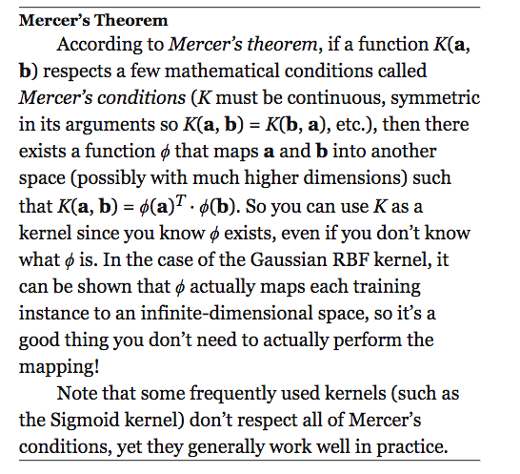
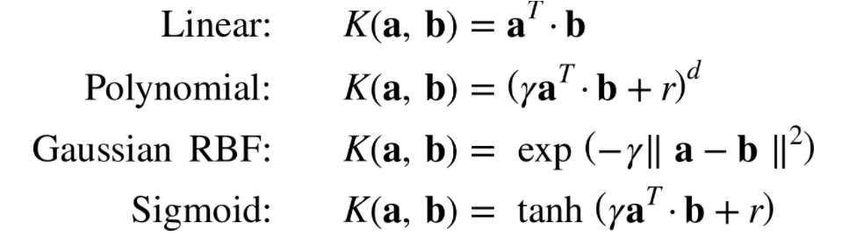
Kernel trick
Usual Kernels

Slide 22
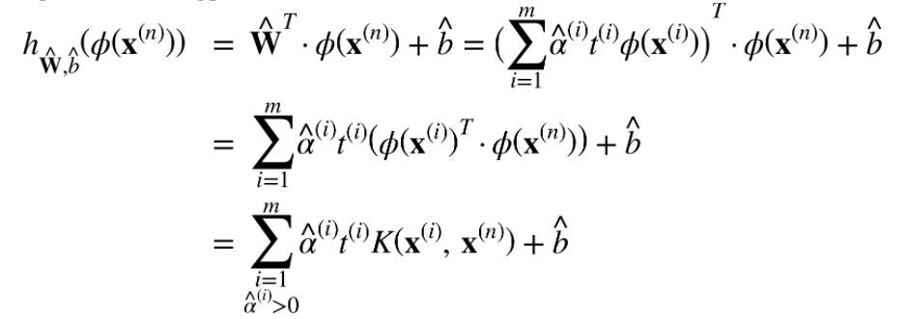
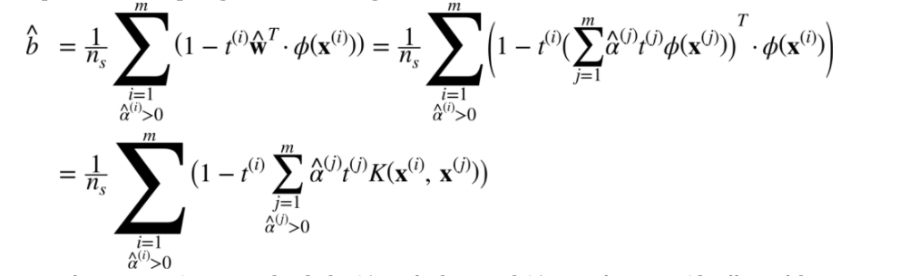
Making prediction on kernelized SVM

Slide 23
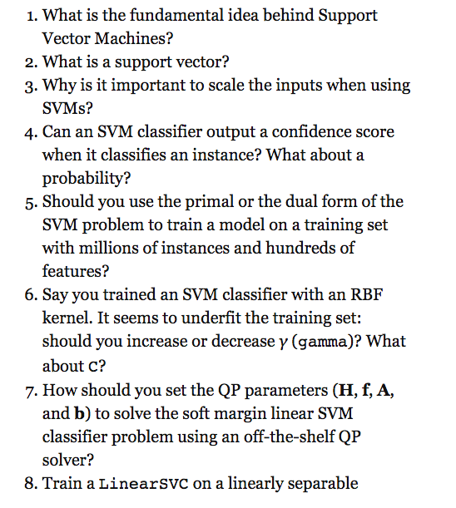
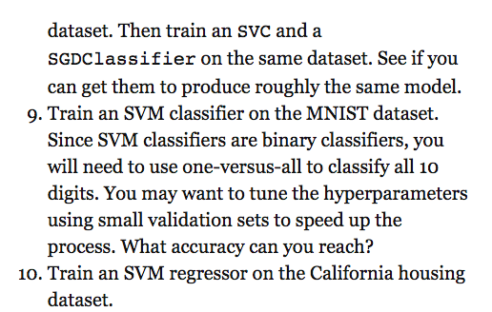
Exercices

Slide 24
Next course
Arbres de Décision
David Rousseau

